Slide 1
CSE 3021 – Social And Information Network MOVIE RECOMMENDER SYSTEM (Review-2)
Team Members
Reg. No. Name
16BCE1100 MUDIT BHARTIA
16BCE1187 ABHISHEK PILLAI
Faculty : Dr.L.Jani Anbarasi
VIT, Chennai.

Slide 2
Abstract
Implemented a movie recommendation system using the movie dataset from the internet .
The goal is to implement collaborative filtering technique to provide the best results.
We will evaluate the advantages and shortcomings and then also discuss how we can improve on this approach.

Slide 3
Motivation
The amount of content that is being generated by social media sites, movies, tv shows etc is increasing tremendously and its very hard for a user or person to choose from such a huge pool of content.
There are endless choices. Hence we need to filter out most of these content and give suggestions to user.
Recommendation systems are designed to solve this very problem to give users best suggestions based on existing data and the user preferences.

Slide 4
Existing System
Recommendation systems are widely used in e-commerce sites such as Netflix to suggest movies , amazon to suggest products, music application such as iTunes and spotify to suggest next songs that the user may like to hear. It can be applied to even domains such as social networking. Facebook uses it for suggesting friends.

Slide 5
Proposed System
In this project we implement a collaborative filtering recommendation system that uses existing data to give better suggestions.
Our Movie Recommendation Engine is Based on Python which uses the PCS(Pearson Correlation Similarity) Measure to solve for the *closest in likings* users to estimate ratings given to movies by a user which is a Collabrative Filtering Methodology.

Slide 6
Software Requirements
PYTHON
Pandas,mean_squared_error,KMeans and numpy library

Slide 7
Modules
In general recommendation systems are implemented in three ways:
Collaborative filtering
PCS(Pearson Correlation Similarity)
K-Means clustering

Slide 8
Collaborative filtering
Collaborative filtering methods are based on collecting and analysing a large amount of information on users’ behaviours, activities or preferences and predicting what users will like based on their similarity to other users.
A key advantage of the collaborative filtering approach is that it does not rely on machine analysable content and therefore it is capable of accurately recommending complex items such as movies without requiring an "understanding" of the item itself

Slide 9
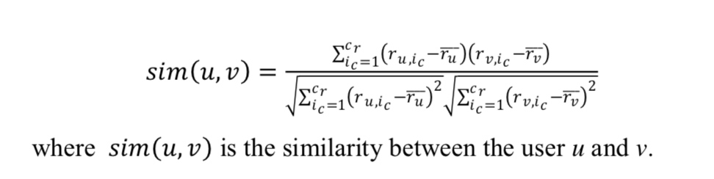
PCS(Pearson Correlation Similarity)
The similarity is measured using the rating preferences provided by the users.
In pearson correlation coefficient, the co-rated cases are isolated to make the correlation computation accurate. The pearson correlation coefficient for calculating the similarity between the user u and user v is defined as in

Slide 10
K-Means clustering
After finding the similarity using the Pearsons Correlation Similarity measure
The Engine then uses __K-Means clustering__ to cluster movies of similar genre into groups for boosting the performance and accuracy of predictions.
We have also made a basic terminal app which asks the user to rate certain movies and the recommends genre based on ratings as well as show to closest users thus predicting age,sex etc.

Slide 11
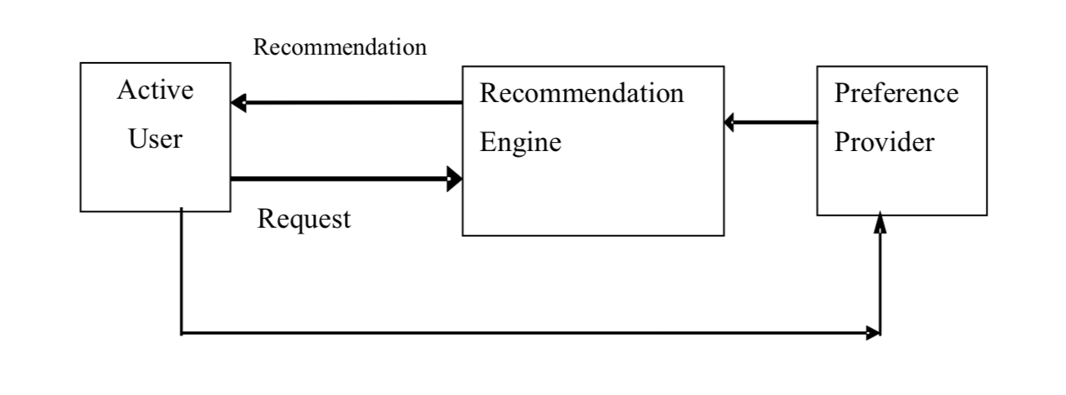
Design

Slide 12
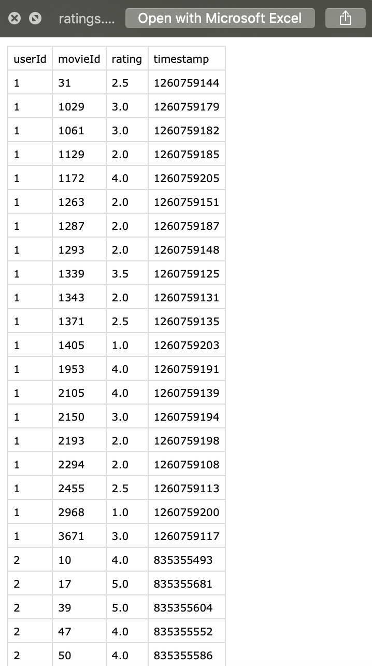
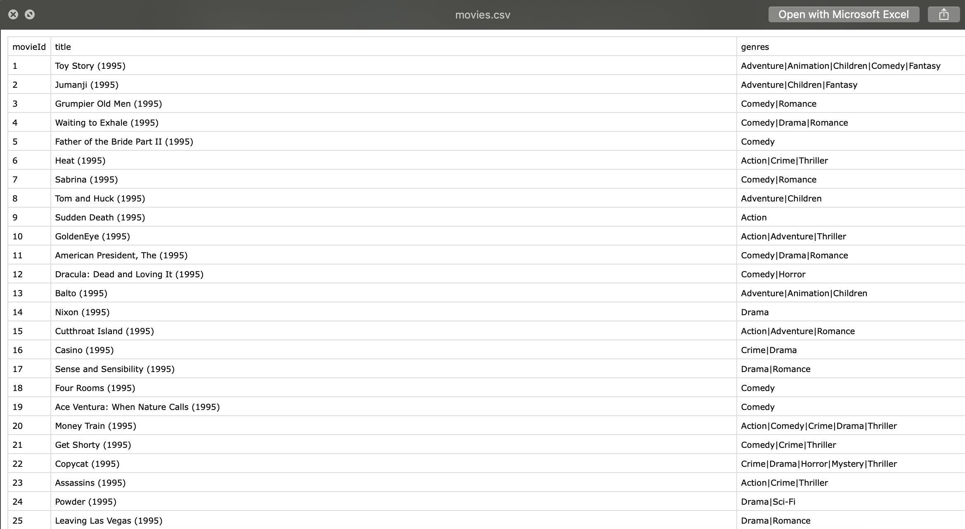
Datasets
The datatset used for the training and testing of the engine is the MovieLens100K dataset. It is available online.

Slide 13
Implementations
We have attached some screenshots of the implementation of our project.
These are the working of our code for finding and calculating the similarity matrix based on the dataset collected.

Slide 14
Implementation

Slide 15
Implementation

Slide 16
Work Plans for 3rd Review
Implement the code and produce a working model of the recommender system.

